Slide 1
Increase Enrollment in My HealtheVet (MHV) Sprint 2 Demo 2
October 28, 2014

Slide 2
Sprint 2 Demo 2 – User Stories
Add/Display VistA MHV Enrollment questions screen
As a VistA user, during pre-registration of a Patient, I want to capture the Patient's status with each of the three MHV enrollment questions so that this is documented and accessible the next time the Patient record is accessed.
(backlog) Actions with date stamp displayed on Alert page.
(backlog) Question "Were you successful in creating your My HealtheVet account during your last visit?" (Y/N): “ displayed on Alert page if enrolled is not “Y” and appropriate action selected.
(backlog) 6th socialization choice added “No - I don’t have a computer / internet access”.
(backlog)Text for all messages associated with socialization responses updated “We are strongly encouraging patients to use My HealtheVet…”

Slide 3
Sprint 2 Demo 2 – Functional Flow
Alert
Socialization
Enrollment Fields
Select Patient
Preregistration
if “N” or “Unanswered” for less than 6 months
If patient was successful in creating My HealtheVet account
Alert to Socialization Detail
Alert
If “unanswered”
Not
successful
Socialization Responses (1-6)
Socialization Actions

Slide 4
Sprint 2 Demo 2 – Demo Flow
Alert
Socialization
Enrollment Fields
Select Patient
Preregistration
Demo Path 1 – New Patient
A, B, C, D
Yes - enrolled
Enrolled auto Yes – Auth set to Action
A.
Demo Path 2 – Returning patient < 6M
A, D
Enrolled Status = Yes, Auth = No
B.
B1.
if “N” or “Unanswered” for less than 6 months
Enter “^MHVF” (jump 6 months)
Demo Path 3 – Returning patient > 6M
A, B1, D
shows actions then status screen (already enrolled)
If patient was successful in creating My HealtheVet account or already enrolled
C.
C1.
Enter “^MHVR” (set to today)
Demo Path 4 – New Patient
A,B,C,D
No – but interested
Enrolled : set No (will change in Sprint 3)
D.
Enter “^MHVF” (jump 6 months)
Demo Path 6 – New Patient - Socialization Menu enhancements including opt 6
Start with Socialization Option 6
All options
Demo Path 5 – Returning patient > 6M
A, B1, C1
Actions with Alert - Successful? “Y”
Enrolled Status = Yes
Enter “^MHVR” (set to today)

Slide 5
Enrollment field decision tree Sample Status Display
BACKUP DATA

Slide 6
IEMHV ENROLLMENT FIELD DECISION TREE – Demo Path
Enrollment Status (1. to edit, <RET> to continue)
Continue
<RET>
entered
Enrolled:
Authenticated:
Secure Messaging:
1. entered
Enrolled (Y/N)
Yes
No
Authenticated (Y/N/A)
Reason Code
Patient Message
Enrollment Status
Yes
No
Action
Opted-in(Y/N/A)
Reason Code
Action list
Yes
No
Action
Enrollment Status
Enrollment
Status
Reason Code
Action list
Enrollment Status
Notes:
Number boxes indicate demo paths followed and sequence.

Slide 7
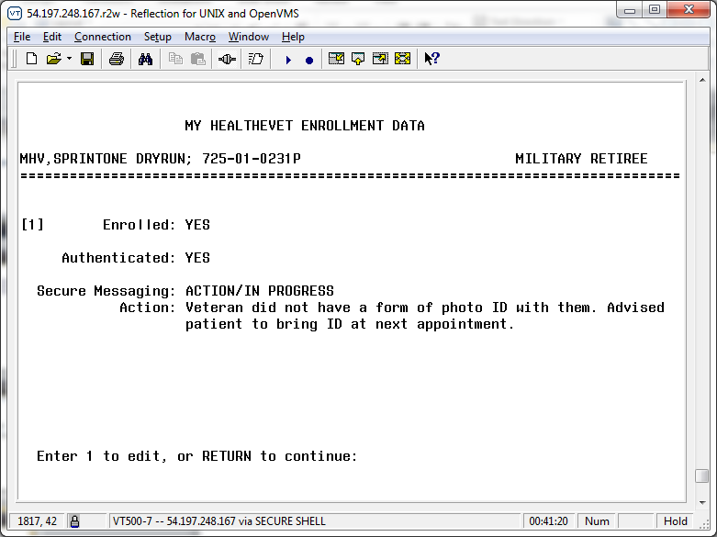
Enrollment Fields Sample Enrollment Status Screen

